Slide 1
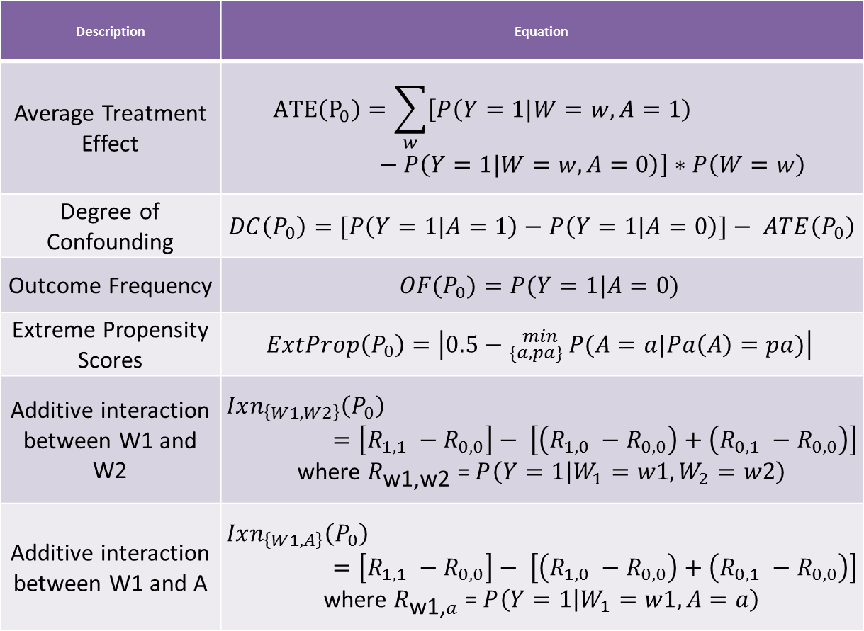
Features
Description | Equation
Average Treatment Effect | $$ATE\left(P_{0}\right)=\sum_{w}{\left[P\left(Y=1|W=w,A=1\right)−P\left(Y=1|W=w, A=0\right)\right]∗P\left(W=w\right)}$$
Degree of Confounding | $DC\left(P_{0}\right)=[P\left(Y=1|A=1\right)−P\left(Y=1|A=0\right)]− ATE\left(P_{0}\right)$
Outcome Frequency | $$OF(P_{0})=P(Y=1|A=0)$$
Extreme Propensity Scores | $$ExtProp\left(P_{0}\right)=\left|0.5−{}_{\{a,pa\}}^{min }{ P(A=a|Pa\left(A\right)=pa)}\right|$$
Additive interaction between W1 and W2 | $$Ixn_{\left\{W1,W2\right\}}\left(P_{0}\right)=\left[R_{1,1} −R_{0,0}\right]− \left[\left(R_{1,0} −R_{0,0}\right)+\left(R_{0,1} −R_{0,0}\right)\right]$$ where $R_{\text{w}\text{1,}\text{w}\text{2}}\text{ = }P\left(Y=1 | W_{1}=w1,W_{2}=w2\right)$
Additive interaction between W1 and A | $$Ixn_{\left\{W1,A\right\}}\left(P_{0}\right)=\left[R_{1,1} −R_{0,0}\right]− \left[\left(R_{1,0} −R_{0,0}\right)+\left(R_{0,1} −R_{0,0}\right)\right]$$ where $R_{\text{w}\text{1,}a}\text{ = }P\left(Y=1 | W_{1}=w1,A=a\right)$

Slide 2
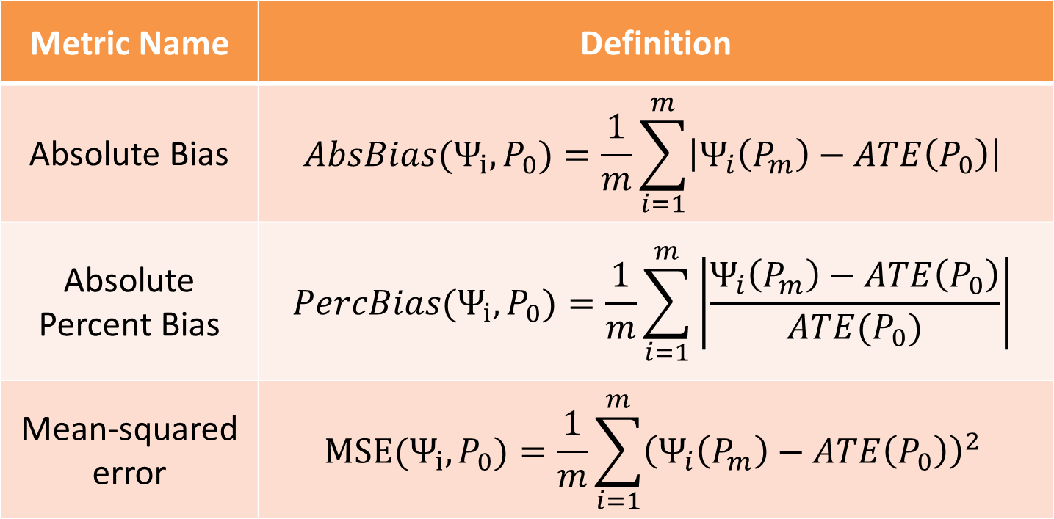
Performance Metrics
Notes:
P_m is the mth sample distribution, phi_i is an analysis method or estimator.

